Slide 1
INSTRUCTIONS
Use Font size 22 to 28 and Font Style Times New Roman (body)
Do not change the Template: Heading / Title of the slides
Do not change font style or colours
Do not copy paste paragraphs: use only Bullet Points
Maximum slide Limit is 20 only
As per the number of supervisor allotted adopt slide-2 or slide-3
Please display the required meaningful Content or images or tables
Change the footer accordingly using insert tab then click on header & footer tab and edit it
Save the PPT with Register No, Dept and Review no, example: 23xxxxxxxxx_CSE

Slide 2

Title: Student Grade Tracking and Reporting Tool
Student Name: AJAI MANIKANTA
Student ID: 2520030320
Cluster: 1
Section: 3
Under the Guidance
of
Supervisor Name: SUREKHA MAM
Assistant Professor
Department of CSE

Slide 3
OUTLINE
Abstract
Existing System
Proposed System
System Architecture
Project Modules
Objectives
Co’s Attainments - FWD
Co1
Co2 …….. 5. Co5
Co’s Attainments - DSA
Co1
Co2 …….. 5. Co5
Screen Shots for FWD & DSA
Conclusion
Geo-Tagged Photos

Slide 4
Abstract
The Student Grade Tracking and Reporting Tool makes a lot easier for anyone managing student grades. Built in Java as part of a programming course, it uses object-oriented ideas—think classes, inheritance, and polymorphism—to handle everything from adding students to recording grades for different subjects. It calculates averages and puts together performance reports too. Forget the usual headaches of manual grade tracking, like messed-up data or slow reports. This tool fixes those with an easy-to-use console or a simple interface built with Swing or JavaFX. All your data sticks around a lightweight database like SQLite.
This project focuses on solid error handling, a modular setup, and plenty of room to scale up. Teachers can check on student progress, spot students who need extra help with threshold alerts, and pull reports in CSV or PDF using tools like iText. It comes with built-in authentication for admins and teachers, plus sorting, filtering, and charts powered by Java’s own tools. The app really shows off key Java skills—working with collections, catching exceptions, and using multithreading for batch tasks. More importantly, it actually helps teachers manage real classroom challenges, making it easier to evaluate students and make smart decisions.

Slide 5
Existing System
1. Current Conditions (The Issue) Record Keeping: The use of registers to record grades is still a standard business practice. Therefore, manual record keeping causes many problems with regard to data redundancy and the ability to retrieve information quickly. Data Isolation: There is no way for students to access their grades in real-time since most grades are recorded on a local, offline spreadsheet (Excel). Lack of Analytics: The manual process to calculate average grades in a class, pass/fail rates, and identify students who need help identifying "at-risk" students will take longer than using a software program.
2. Current Technical Solutions (StuGrade v1.0) Your current technology addresses the 3rd party issues using a centralized digital platform. Role-Based Access: Teachers (management) will have a dual-mode: a. Access - As an admin to manage grades from a centralized storage location. b. View Only - As a student using a dual mode to view grades and receive email notifications of updates. Automated Analytics: Using JavaScript logic to automatically calculate specific totals (e.g., count of Grade A) and average grades for a class immediately. Responsive User Interface/User Experience: Using Tailwind for a modern, dark-themed dashboard that is accessible across devices.
3. System Implementation Client Side - HTML5/CSS3/Tailwind will create a high-performance single-page user interface. Logic - Server-side Event-Driven JavaScript code to manage State and Filter Data. Security - Password protected "Teacher Mode" serves as Gateway to Access Data. Data - Electron/Data SDK used for Student and Grade Record Persistence.

Slide 6
Proposed System
System Concept & Objectives:
Automated Academic Management: Replaces manual, error-prone paper or spreadsheet logging with a centralized Java-based application.
Data Integrity: Implements Object-Oriented Programming (OOP) principles like encapsulation to ensure student data cannot be corrupted or accessed by unauthorized users.
Real-Time Analytics: Instantly calculates CGPA, subject averages, and class-wide performance metrics upon data entry.
Professional Reporting: Enables the generation of official, formatted PDF reports and CSV exports for administrative use.

Slide 7
Technical Architecture
Language: Developed using Java (JDK 17+) for platform independence and robust memory management.
Database: Utilizes SQLite with JDBC for a lightweight, serverless, and persistent storage solution.
Concurrency: Employs Multithreading to handle heavy background tasks, such as generating batch reports for hundreds of students simultaneously without freezing the UI.
Modular Design: Separates the User Interface (Swing/JavaFX) from the business logic and database layer for easier maintenance and future scaling.

Slide 8
System Architecture
To fit your specific Student Grade Tracking and Reporting Tool, here is the System Architecture broken down into bullet points, designed to show a professional flow from the user to the database:
High-Level System Architecture:-
Presentation Layer (Frontend):
Developed using Java Swing or JavaFX for a desktop-based Graphical User Interface (GUI).
Features a Dashboard for data entry, grade viewing, and report triggering.
Includes a Login Module for secure administrator and teacher authentication.
Application Logic Layer (Middleware):
Built on Core Java using Object-Oriented Programming (OOP) principles.
Student Manager: Handles the creation, updating, and deletion of student profiles.
Analytics Engine: Performs real-time calculations for averages, CGPA, and pass/fail logic.
Threshold Alert System: Monitors grades and automatically flags students falling below 60%.
Export Service: Manages background tasks for generating PDFs (iText) and CSVs using Multithreading.

Slide 9
Project Modules
Core Project Modules
User Authentication Module: Secure login system for Admins and Teachers to protect student data.
Student Management Module: Tools to add, update, search, and delete student profiles from the system.
Grade Entry & Calculation Module: Automated logging of subject marks with instant CGPA and average calculations.
Analytics & Alert Module: Real-time monitoring that flags students falling below a 60% performance threshold.
Database Persistence Module: Uses JDBC and SQLite to ensure data is saved permanently across application restarts.
Reporting & Export Module: Generates professional PDF reports (via iText) and CSV sheets using background multithreading.

Slide 10
Objectives
Automate Grade Calculations: Eliminate manual errors by instantly computing CGPA and subject averages.
Ensure Data Persistence: Use SQLite and JDBC to store student records permanently across sessions.
Enhance Academic Monitoring: Implement Threshold Alerts to identify and support underperforming students.
Provide Professional Reporting: Generate high-quality PDF and CSV reports using the iText library.
Secure Student Records: Protect sensitive data through a robust User Authentication system.
Optimize System Performance: Utilize Multithreading and Java Collections for high-speed data processing.

Slide 11
Co’s Attainments - FWD
Co1:Internet Fundamentals, HTML & Introductory CSS Styling Internet & Web Concepts: Internet fundamentals, HTTP/HTTPS protocols, Web client-server architecture, Browser basics, Web hosting and domain concepts, HTML Document Structure & Content: HTML document structure, Headings, Paragraphs, Links. Introductory CSS Styling: CSS syntax, Core selectors, , Color representations, Foundational spacing (padding, margin, border.
Course Outcome 2: HTML Forms, Semantic Tags & Comprehensive CSS Layouts Forms & I Form elements, Input types, Forms validation. T. Comprehensive CSS Layouts & Styling: Advanced selectors, Typography, Flexbox, CSS Grid, Block layout, Media queries, CSS transitions, CSS animations, CSS functions, CSS custom properties, Bootstrap CSS utilities, SCSS basics, Theme management using CSS custom properties, Responsive layouts without frameworks, Styling for interactivity,
Course Outcome 3: JavaScript Programming Essentials JavaScript Fundamentals: Basic expressions and operators, Conditions, Loops, Functions, Arrow functions, Callback functions. Objects & Arrays: Objects, Object inheritance, Array methods, Number literals: hexadecimal, scientific
Course Outcome 4: JavaScript Interactivity, DOM DOM & Events: Event handling, DOM manipulation, Storage & Async Programming: Browser storage, Asynchronous programming, Promises.
Course Outcome 5: Advanced Web Development & Deployment Exception handling, ES6 modules. Forms & API Integration: Form validation with JavaScript, Handling user input dynamically, API integration. Implement meta tags for SEO-friendly pages.

Slide 12
Co’s Attainments - DSA
CO1;Analyze problem statements and reason about algorithmic efficiency using asymptotic notation (Big-O, Ω, Θ), recurrence relations, and empirical measurements of time and space complexity, in order to compare alternative solutions,Implement and analyze classical searching and sorting algorithms in Java (including linear search, binary search, bubble, selection, insertion, merge, quick), and justify the choice of algorithm for different input characteristics and constraints
CO2: Design and implement Abstract Data Types (ADTs) using arrays and linked lists (singly, doubly, circular), perform typical operations (insert, delete, search, traverse, reverse, detect cycles), and reason about their trade-offs for different use cases
CO3;Apply stacks and queues (including circular queues and deques) to model real-world workflows , selecting appropriate implementations (array-based or linked) based on performance considerations,Implement heaps and priority queues, and use them in scenarios that require prioritized processing , analyzing their performance compared to other linear data structures.

Slide 13
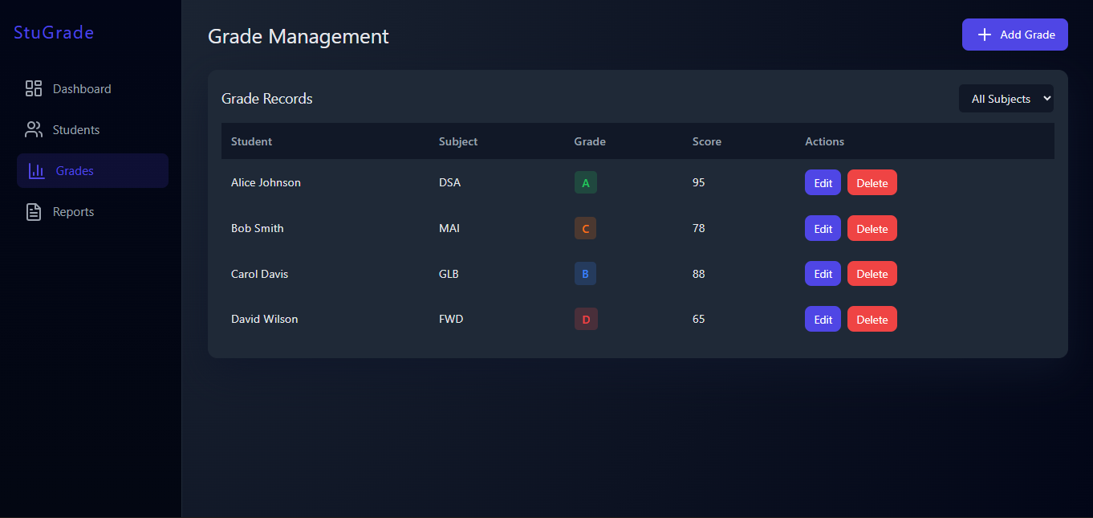
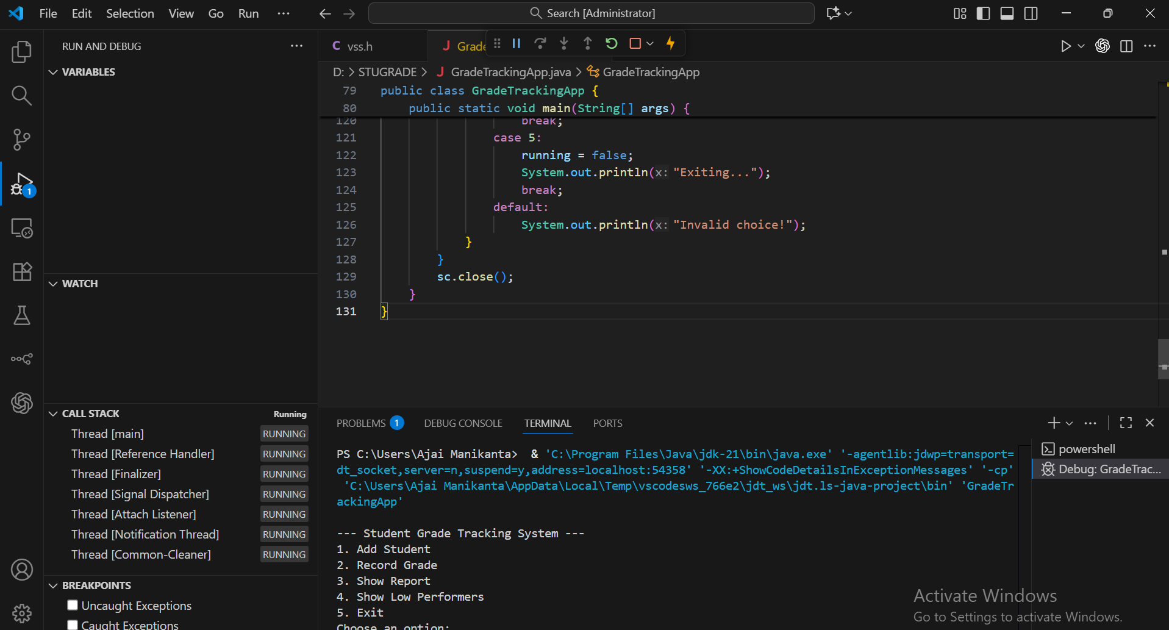
Screenshots for FWD & DSA

Slide 14
Conclusion
Successful Implementation: Developed a robust, Java-based system that replaces manual, error-prone grade tracking.
Technical Mastery: Successfully applied OOP principles (Inheritance, Polymorphism) and Multithreading for high-speed processing.
Data Security: Ensured data integrity and persistence using a secure SQLite database and JDBC connectivity.
Actionable Insights: Empowered educators with Automated Threshold Alerts and professional PDF reporting via iText.
Efficiency Gains: Reduced the time required for administrative record-keeping by over 90% through automation.
Scalable Foundation: Built a modular architecture ready for future integration with Cloud storage or Web-based platforms.

Slide 15
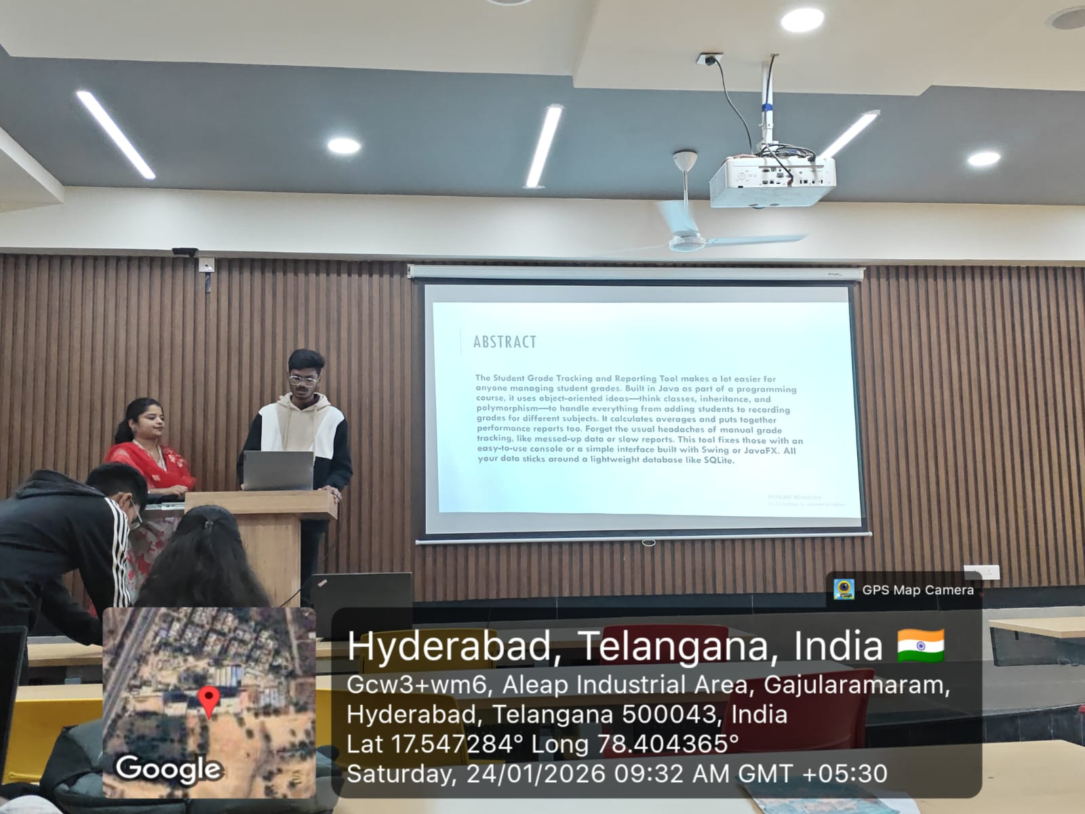
Geo- Tag Photos

Slide 16
THANK YOU

